Slide 1


Artificial Intelligence in Product Development
AI is revolutionizing product development, enabling faster innovation, better design, and improved efficiency.
by ShaTech jsjk

Slide 2
Ideation and Concept Generation with AI
AI-Powered Idea Generation
Concept Exploration
AI algorithms can analyze vast datasets and identify trends, patterns, and unmet needs, generating novel product ideas.
AI can help explore various product concepts by suggesting different features, functionalities, and potential designs.

Slide 3

Enhancing Creativity and Design with Generative AI
Design Exploration
Material Exploration
Generative AI models can create unique product designs, explore different aesthetic styles, and suggest innovative forms.
AI can assist in finding the optimal materials for a product, considering properties like durability, weight, and sustainability.

Slide 4

AI-Powered Requirements Definition and Optimization
Automating Requirements Gathering
Prioritizing Features
AI can analyze customer reviews, market data, and competitor information to define comprehensive product requirements.
AI algorithms can prioritize features based on user impact, market demand, and development feasibility.

Slide 5



Accelerating Prototyping and Virtual Product Testing
Rapid Prototyping
Virtual Testing
AI-powered tools can generate 3D models quickly, enabling rapid prototyping and iteration.
AI can simulate product performance in virtual environments, reducing the need for costly physical prototypes.

Slide 6

AI-Driven Material Selection and Optimization
1
AI can analyze material properties, performance, and environmental impact to identify the best material options.
2
AI algorithms can optimize material usage, reducing waste and minimizing manufacturing costs.
3
AI can assist in developing new materials with enhanced properties, addressing specific product requirements.

Slide 7
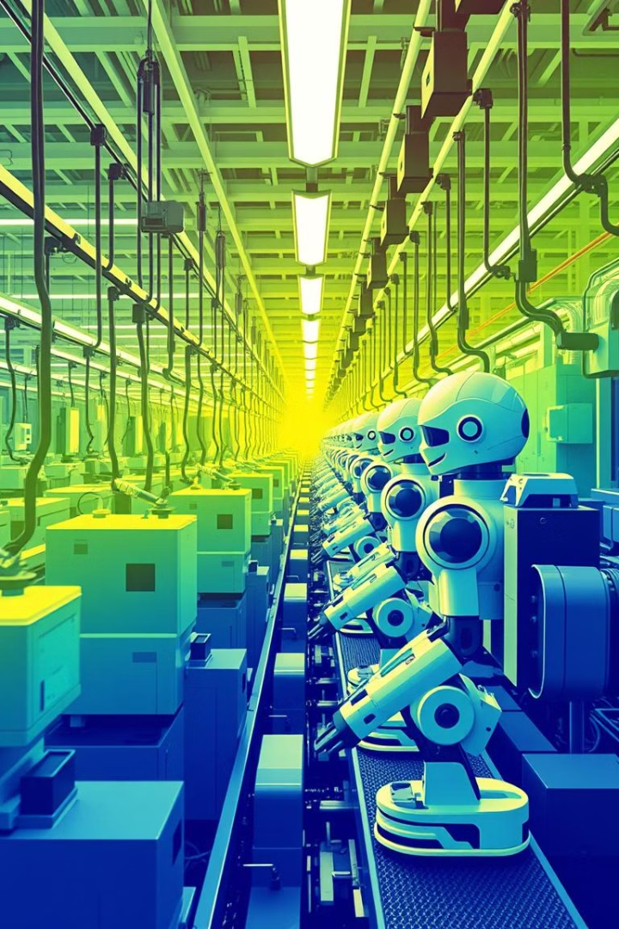



Transforming Manufacturing and Supply Chain with AI
Predictive Maintenance
AI can analyze sensor data from machinery to predict failures and schedule maintenance, reducing downtime.
Inventory Optimization
AI can optimize inventory levels, reducing storage costs and ensuring timely delivery of materials.
Demand Forecasting
AI can analyze historical sales data and market trends to predict future demand, enabling efficient production planning.

Slide 8



Boosting Quality Assurance and Testing with AI
1
Automated Testing
2
Defect Detection
3
Predictive Quality

Slide 9
Leveraging AI for Customer Feedback and Continuous Improvement
1
Sentiment Analysis
2
Feedback Summarization
3
Product Roadmapping

Slide 10
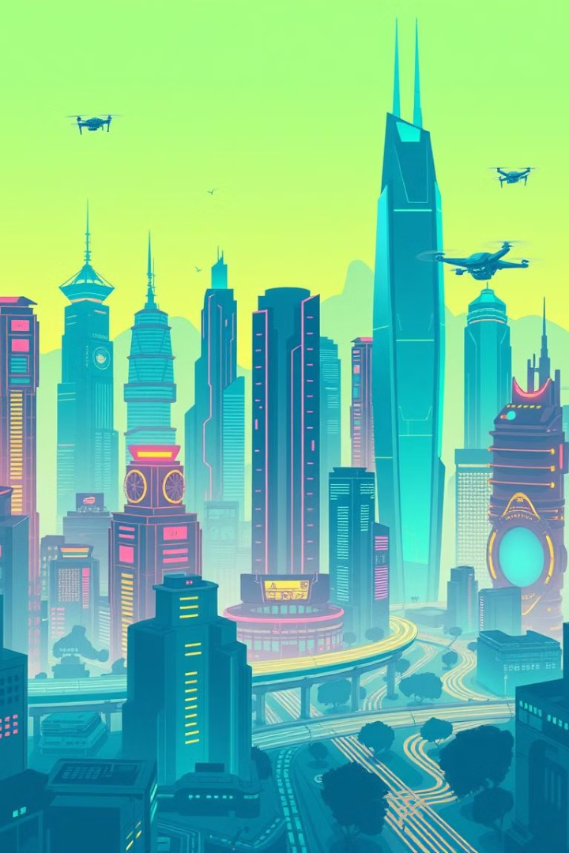
The Future of AI in Product Development: Innovation, Efficiency, and Precision
10x
90%
Speed
Efficiency
AI can accelerate product development cycles, bringing products to market faster.
AI can streamline processes, automate tasks, and optimize resources, leading to greater efficiency.
100%
Precision
AI can enhance product quality and consistency, delivering a superior customer experience.

